Slide 1
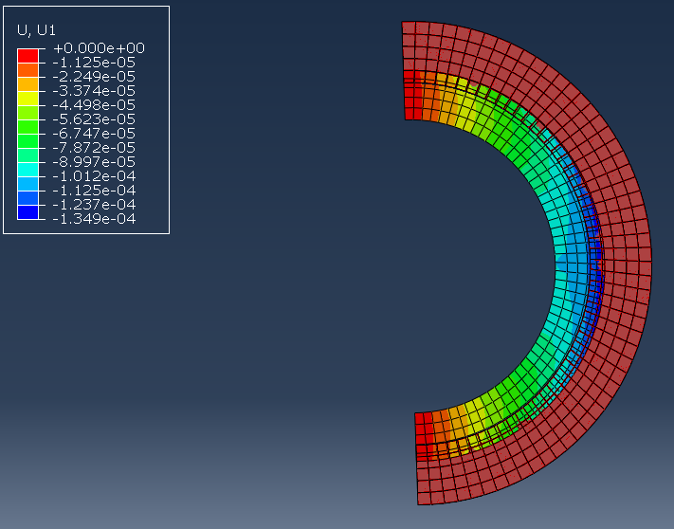
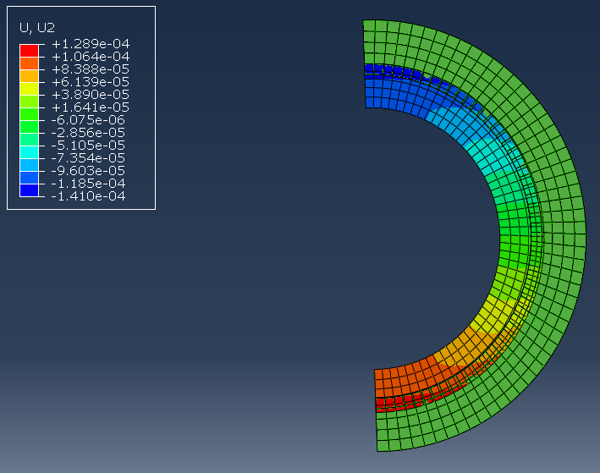
Deflection as result of Cryo cooling process (25C->-182C)
Simple 2D approximation of Ring:
2” Diameter
0.125” thickness
Boundary Conditions:
Symmetry x restrictions
All rotation restricted
Maximum x Deflection: ~-0.01374 inches
Maximum y Deflection: ~-0.0056 inches

Slide 2
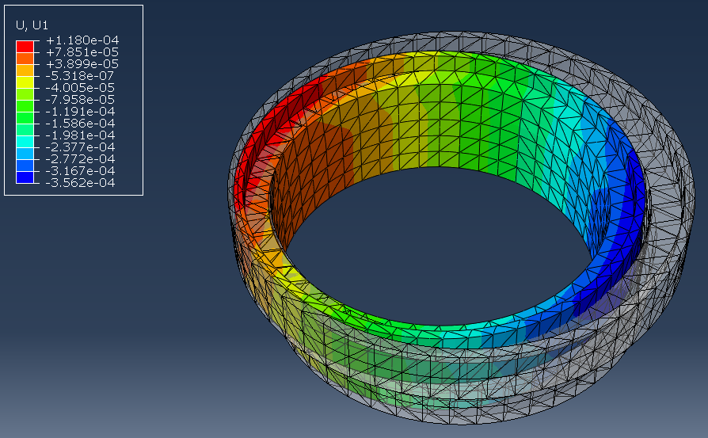
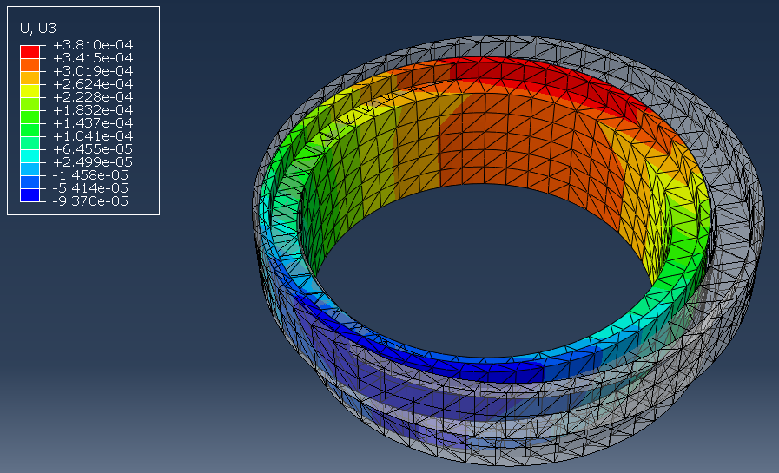
Deflection as result of Cryo Cooling process (25C->-182C)
6061-T6 Aluminum
Boundary Conditions: Restricted Vertical (y) movement, Restricted all rotation
X Direction Maximum Deflection: ~-0.014 inches
Z Direction Maximum Deflection: ~ -0.015 inches

Slide 3
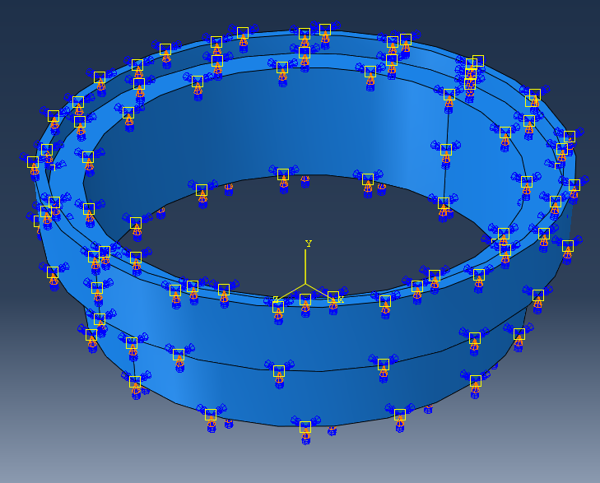
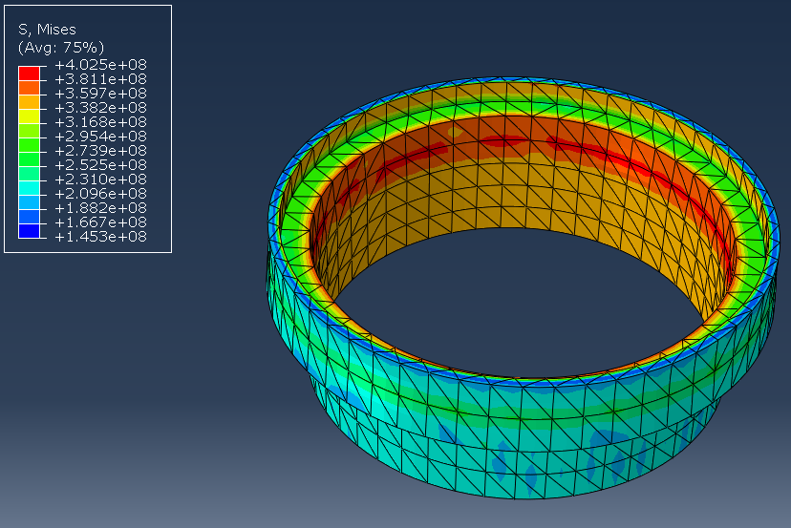
Stress Concentrations (Von Mises Stress)
-based on assumed boundary conditions displayed to the right
-fixed in y, all rotation fixed
-using 2403 element Tet-Quad mesh
Mises stress concentrations appear in red to the left

Slide 4
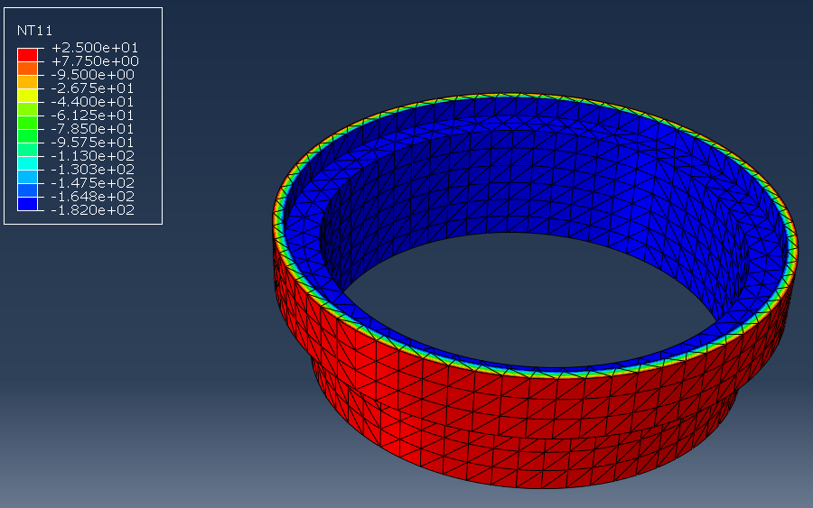
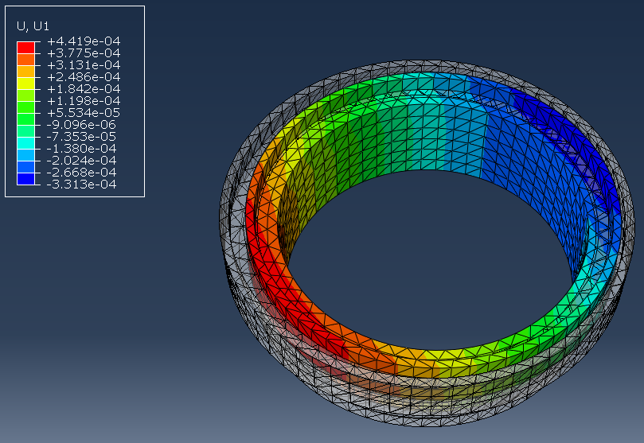
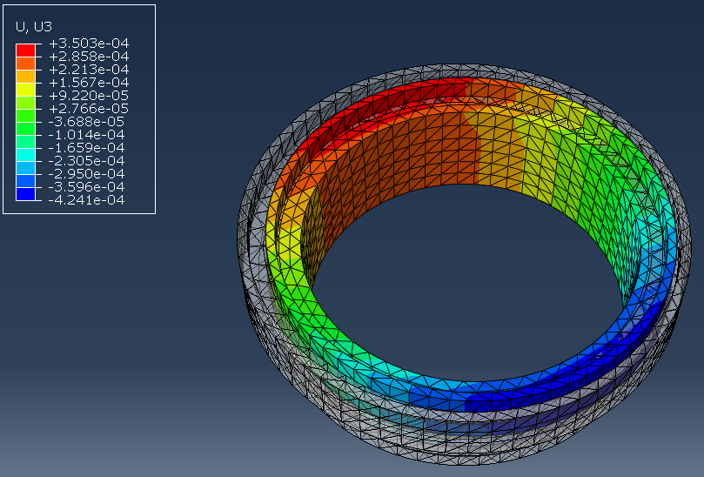
Updated to 3905 element mesh
Steady-state Temperature distribution to be used with Stress Analysis (Degrees C): 25C outer to -182C inner Temps
Maximum deflection values show similar results to previous mesh analysis:
Max X: ~0.0174”
Max Z: ~0.017”

Slide 5
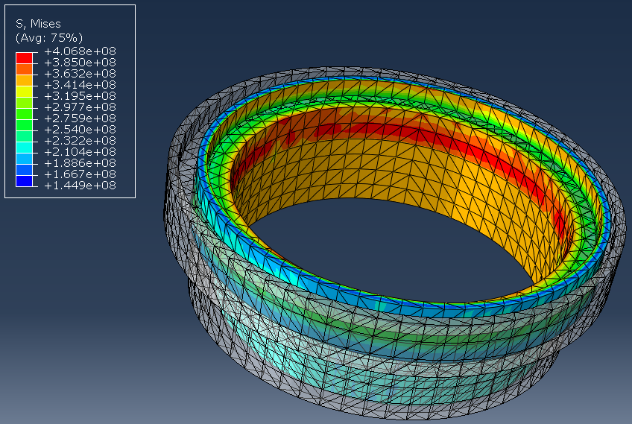
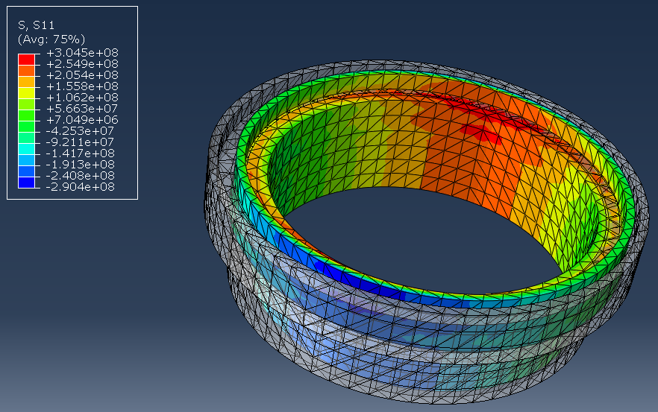
3905 Element Mesh Stress Concentrations (Von Mises):
Assuming same previous boundary conditions
Tensile/compressive stress concentrations:
Build-up on inner edge of mating ring

Slide 6
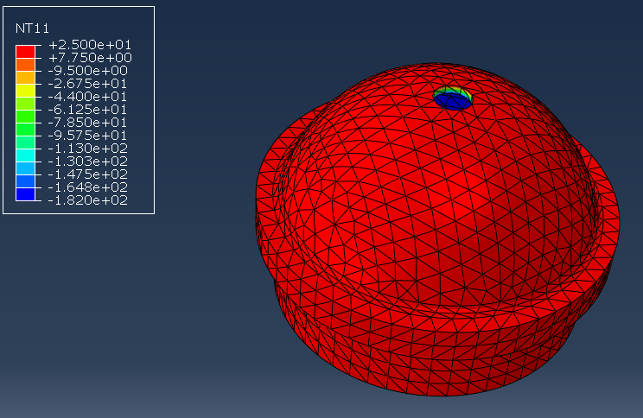
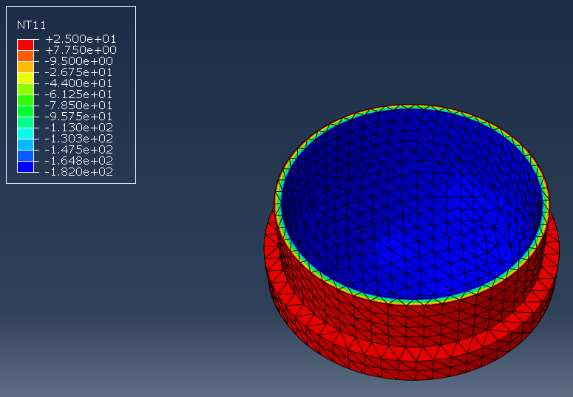
Steady State Endcap Temperature Gradient for use with Steady State Temp analysis (Degrees C):
5317 Element tet-quad mesh
Blue regions= -182C
Red Regions= 25C
Temperature gradient viewed on edge regions in between

Slide 7
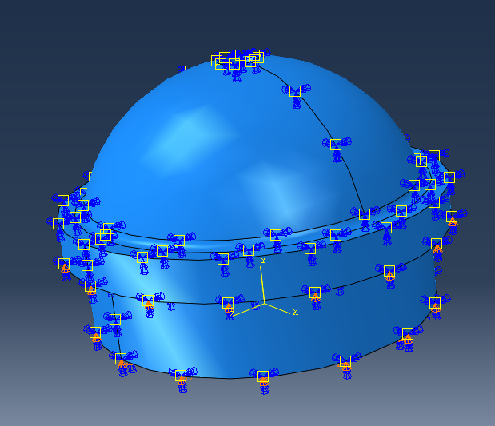
Boundary Conditions for Preliminary Stress analysis:
-All rotation restricted
-Y direction restricted along bottom edges of endcap
Material Properties:
6061-T6 Aluminum
Young’s Modulus = 69 Gpa
Poisson’s Ratio = 0.29
Conductivity @ 25C = 152 W/m*K
Thermal Expansion Coeff = 23.4e-6 m/m*C
Convection Coeff to air =10-100 W/m^2*K

Slide 8
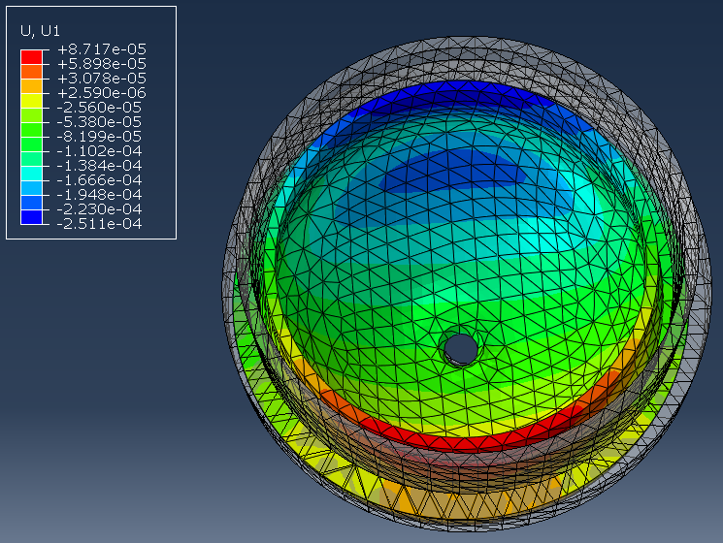
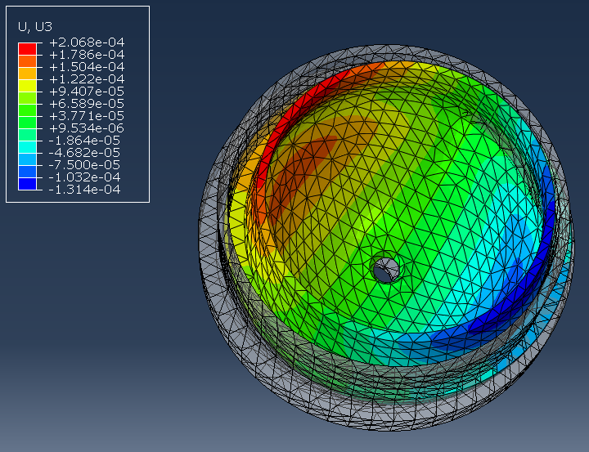
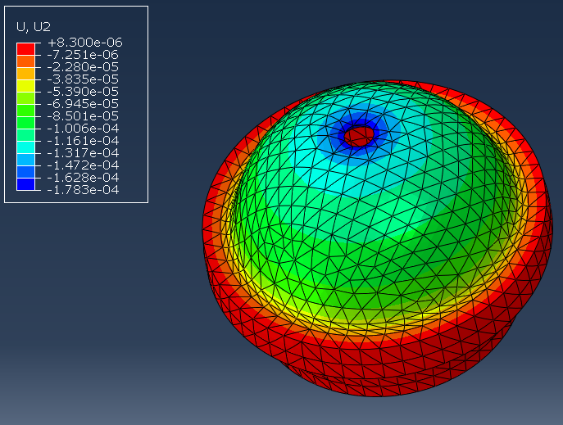
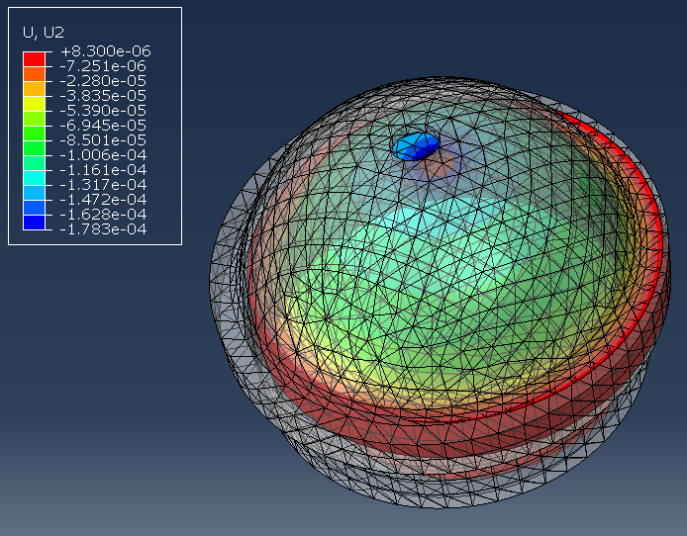
Displacement Analysis using these BC’s:
Max X: 0.009886”
Max Z: 0.008142”
Red & Blue regions represent locations of maximum displacements, with appropriate gradients in between
Max Y: 0.00702”
Y Direction w/ Deformed shape superimposed

Slide 9
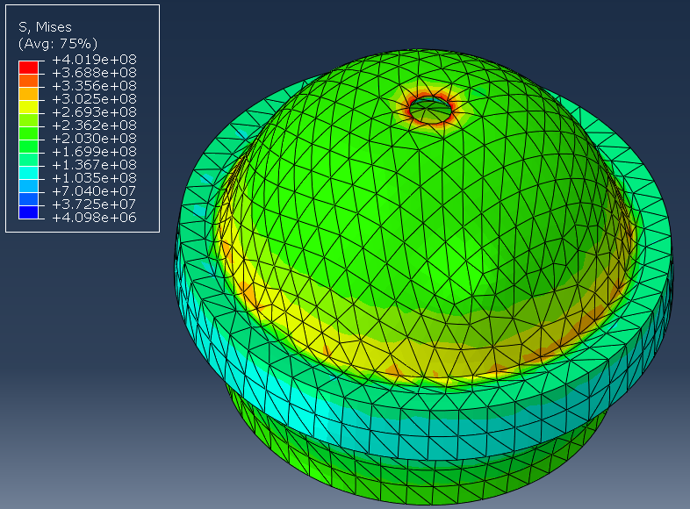
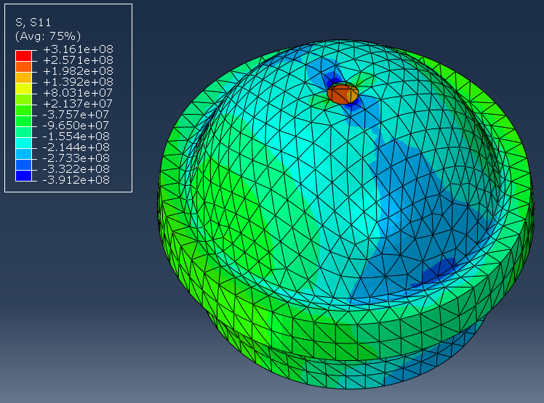
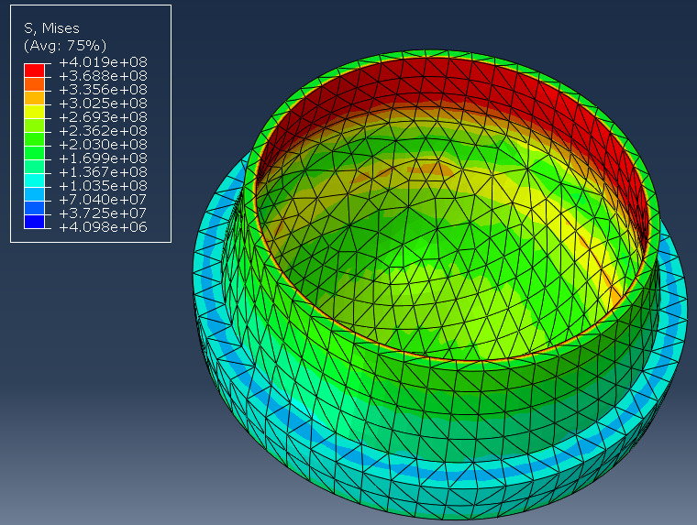
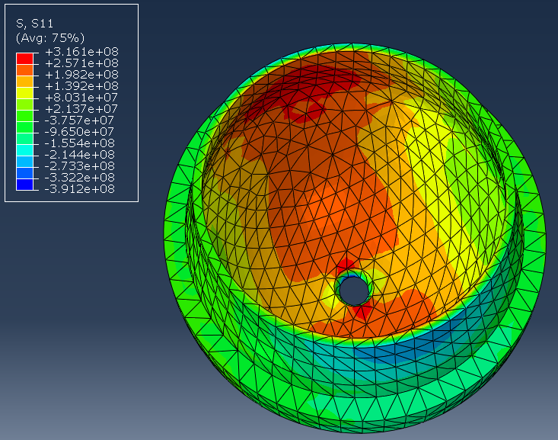
Stress Concentrations with 5317 tet-quad Mesh:
Von Mises Stress
Tensile/Compressive (S11)

Slide 10
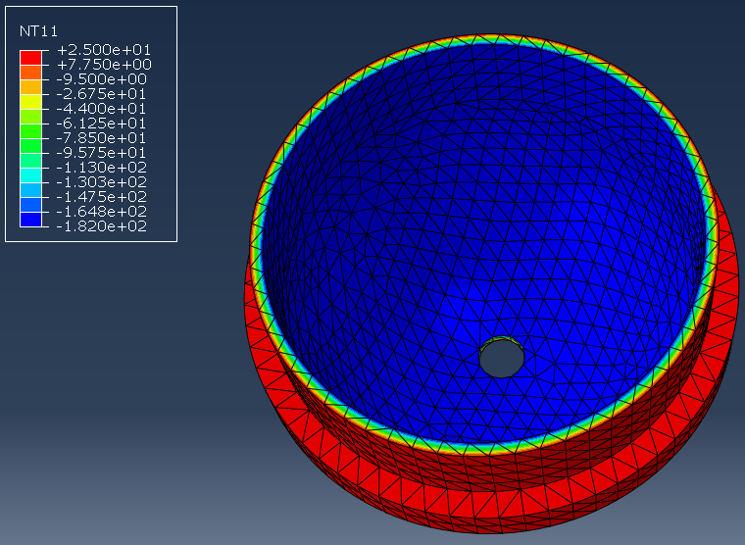
Analysis repeated with 6489 Element Mesh:
Same material properties & boundary conditions
Temperature Gradient:
Red regions = 25C
Blue regions = -182C

Slide 11
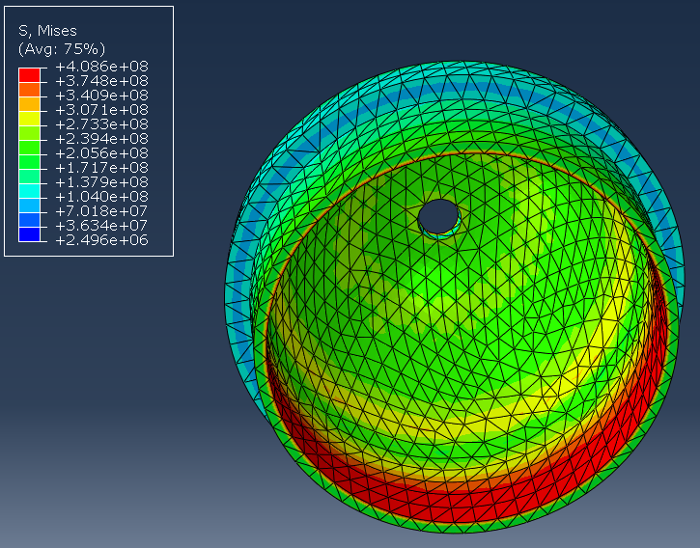
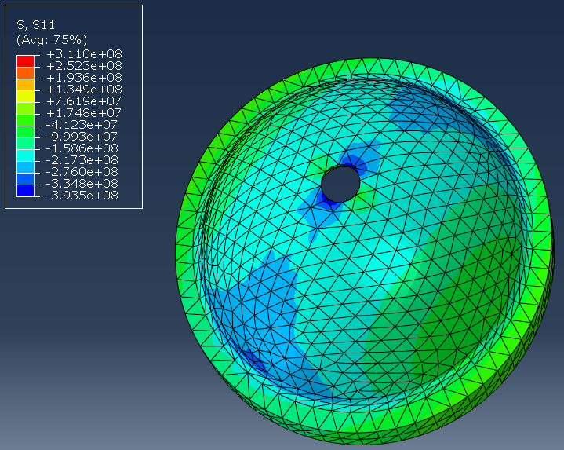
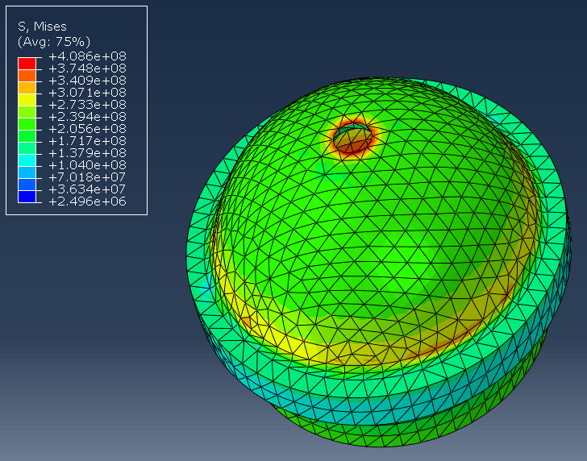
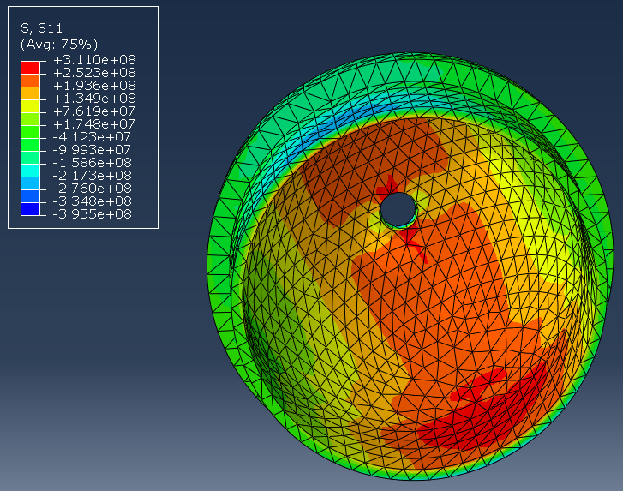
6489 Element Stress Concentrations:
Shows same concentration pattern across both meshes..
Von Mises
Tensile/Compressive (S11)

Slide 12
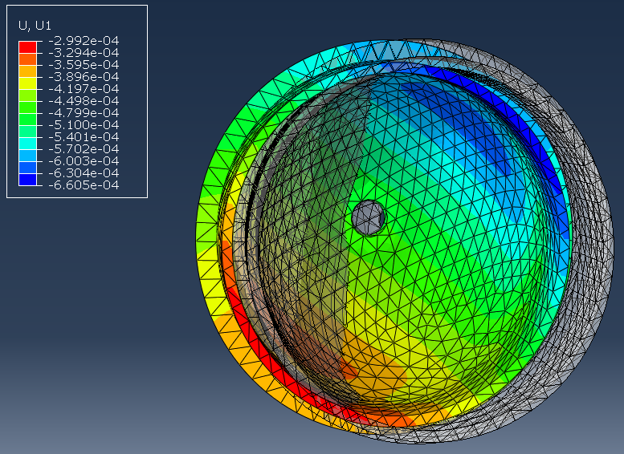
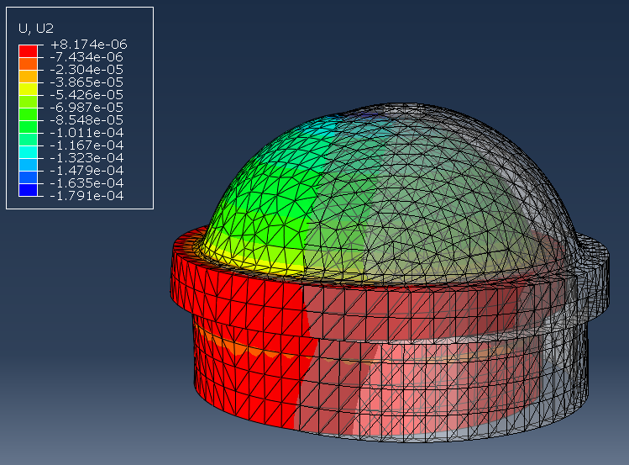
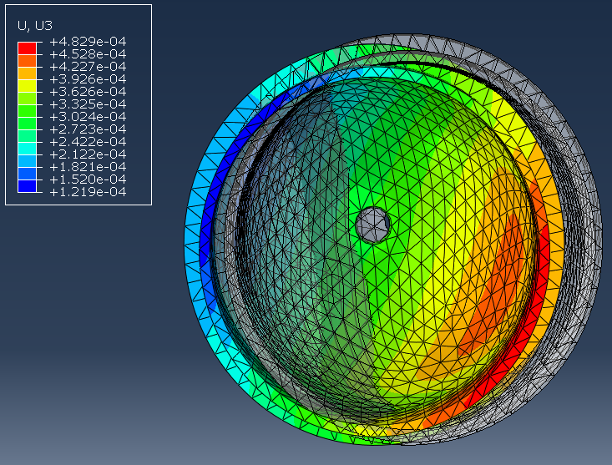
Displacement results somewhat inconclusive using higher element mesh...need to re-examine boundary conditions..
U1 (X) & U3 (Z) values much larger than previous mesh, U2 (Y) correlates
Max x: ~0.026”
Max y: ~0.0071”
Max z: ~0.019”

